Slide 1
Customer Subscription Analysis
Project

Slide 2
Agenda
Data Exploration
Preprocessing the data
Usage of classification-learning methods
Test the learned model

Slide 3
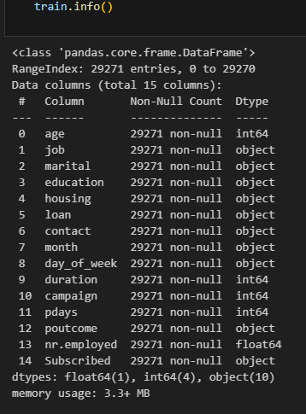
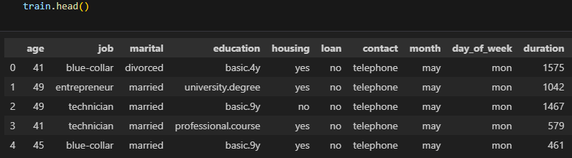
Data Exploration

Slide 4
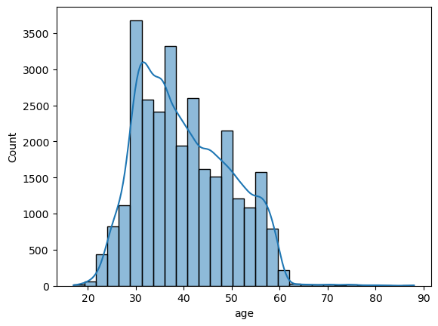
Age

Slide 5
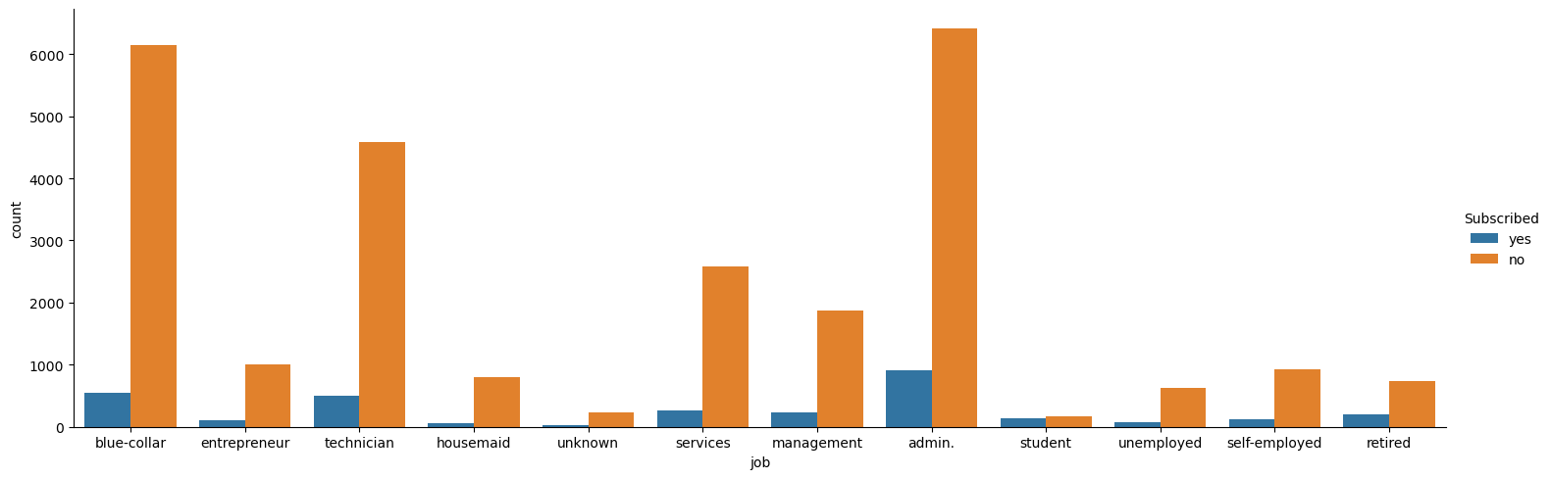
Job

Slide 6
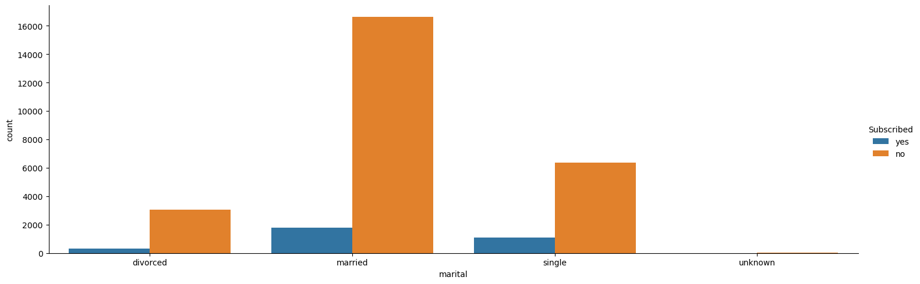
Marital Status

Slide 7
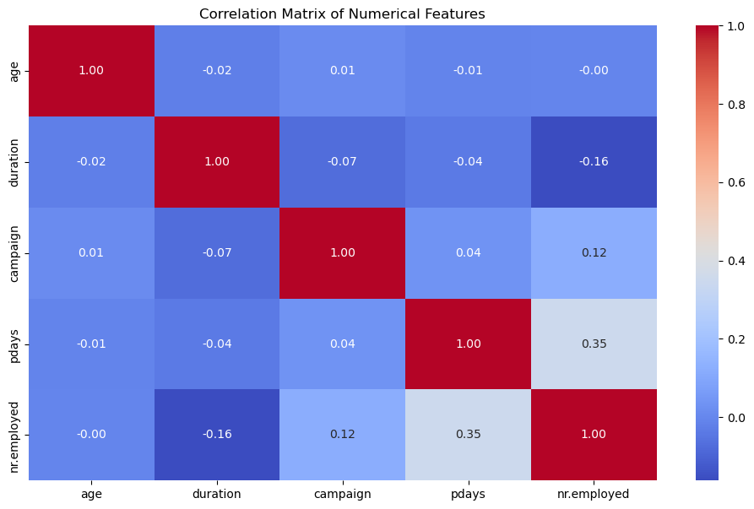
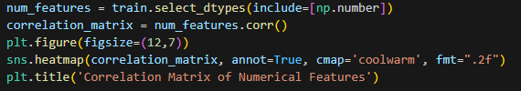
Correlation Matrix

Slide 8

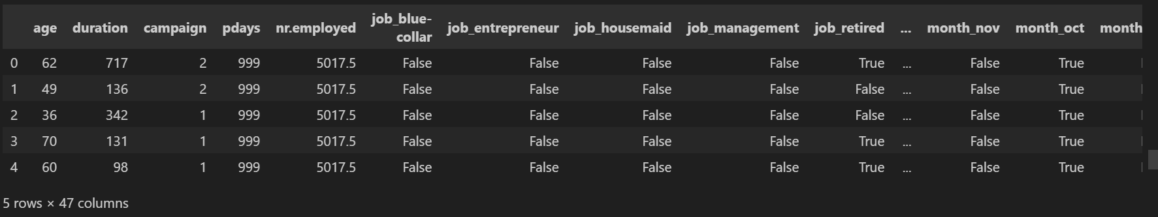

Data Preprocessing

Slide 9
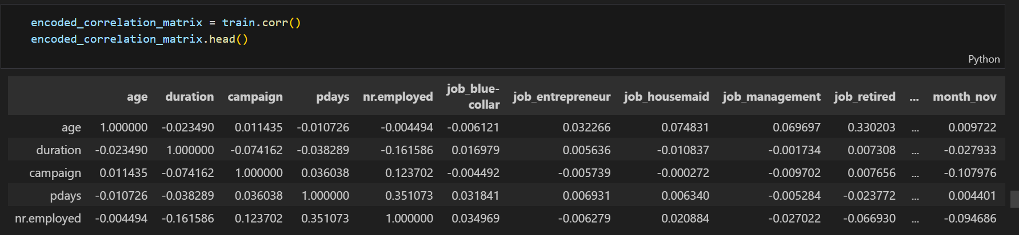
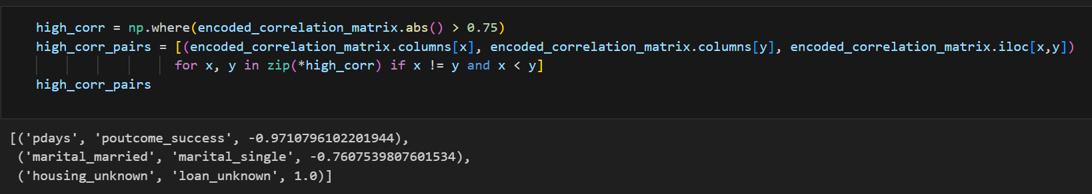
Data Preprocessing

Slide 10
Classification Methods
Decision Tree
Logistic Regression
Linear Regression

Slide 11
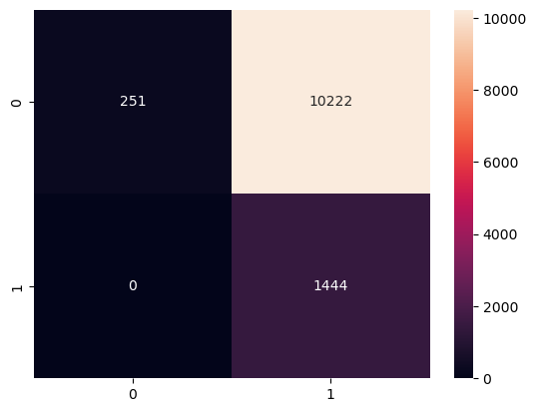
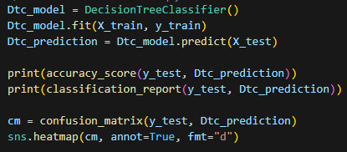
Decision Tree

Slide 12
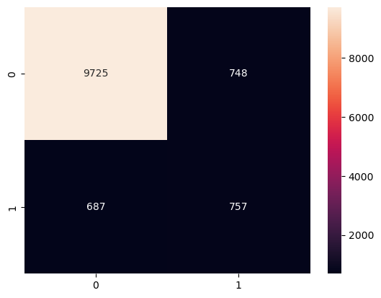
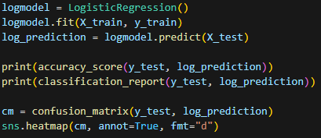
Logistic Regression

Slide 13
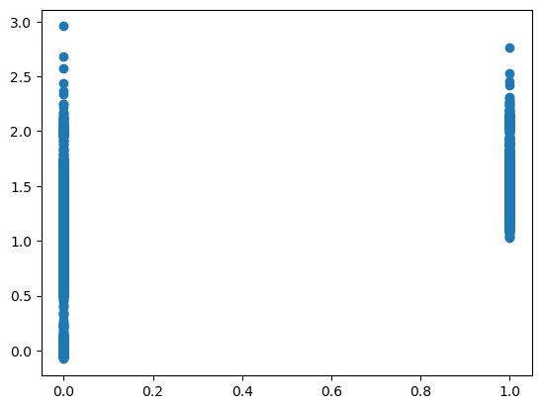
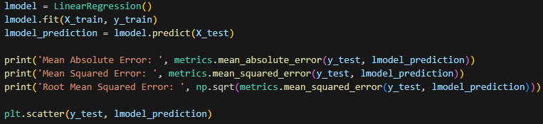
Linear Regression

Slide 14
Model Accuracy Comparison

Slide 15
Thank you!
Uriel Vortia
Vladimir Gvaramadze
Uriel Vortia
Xinfu Guo

